Slide 1


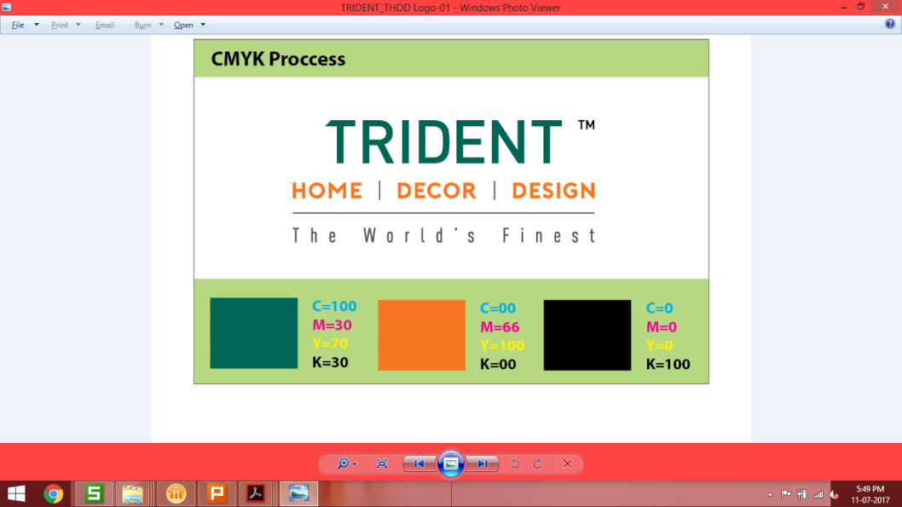









Trident Limited
Home Textile Presentation – May 28, 2019

Slide 2

Agenda/ Issues to be addressed in the CFT
(a) June DP for Q1 and (b) Top Line of Q2 with 50% Growth
Order Book/Competitive Opportunity of 73000 MT – How to Optimize ?
Replacement of Loss Making Orders (Rs. 20 Cr)/Harness Marketing Cost @ 21/Kg
Reduction in COPQ/Avoidable Cost by 40 Crores (Current Cost : 140 Crores)
Improvement in Conversion Cost (Current Higher Cost: 60 crores)

Slide 3

Top Line
Trends & Hurting Points

Slide 4
Towel – Q1 Performance against Mission
Month | Dispatch Mission (MT) |  |  | Achievement %
 | Dhaula | Budhni | Total | Dhaula | Budhni | Total
April,2019 | 2,299 | 2,700 | 4,999 | 81% | 69% | 75%
 |  |  |  | 1,870 MT | 1,857 MT | 3,727 MT
May,2019 | 2,376 | 2,790 | 5,166 | 85% | 99% | 92%
 |  |  |  | DP - 2,024 MT | DP - 2,721 MT | DP - 4,775 MT
 |  |  |  | Required to meet Q1 Target DP ??
June,2019 | 3,081 | 3,612 | 6,693 (216 MT)
(Q1 Target less April Actual Less May DP)
Q1 Target | 6,975 | 8,190 | 15,165
 |  |  |  | Planning required for Q2 Target considering 50% Growth (Capacity: 246 MT)
Q2 Target | 10,463 (110 MT) | 12,285 (130 MT) | 22,748 (240 MT)
FY 19 | Sales(MT) | Capacity(MT) | Utilization %
Trident | 43,161 | 90,000 | 48%
Welspun | ~ 64,000 | ~ 80,000 | 80%
Q1: Current Production : 140
MT agt. 165 MT/Day

Slide 5
Sheeting – Q1 Performance against Mission
FY 19 | Sales(MT) | Capacity(MT) | Actual Utilization
Trident | 22.6 Million Mtr | 43.2 Million Mtr/500 Looms
Welspun |  | 82 Million Mtr/680 Looms | Welspun Monthly Weaving: 7000000 + Job Work from Outside//Full Utilization
 |  |  | Trident Monthly Weaving : 2100000
FY 19 | 22.6 Million Meter | Per Day: 62000 Meters | No Upswing in Q1
April | 15.73 Lac Meter | Per Day: 52000 Meters
May | 19.50 Lac Meters | Per Day: 63000 Meters
Competition Strategy: No Orders to leave, capacity or no capacity/Job Work
June DP and Q2 DP ??

Slide 6
Top Line Trends - Towel Dispatch Volumes
Segment | FY 16-17 |  | FY 17-18 |  | FY 18-19 |  | Growth %
 | MT | % | MT | % | MT | %
US | 32,619 | 71% | 25,712 | 64% | 27,648 (76 MT) | 64% | 15 % De-Growth
EU & UK | 9,951 | 22% | 11,078 | 28% | 10,947 (30 MT) | 25% | 10%
ROW | 1,140 | 2% | 1,124 | 3% | 2,016 (5 MT) | 5% | 77%
Domestic | 2,417 | 5% | 2,141 | 5% | 2,550 (7 MT) | 6% | 6%
Total | 46,127 | 100% | 40,055 | 100% | 43,161 (118 MT) | 100% | 6 % De-Growth

Slide 7
Top Line Trends - Towel GSR/FOB in Foreign Currency
Segment | Currency | % ot Total | FY 16-17 | FY 17-18 | FY 18-19 | Growth %
US | USD | 64% | 6.36 | 6.54 | 6.59 | 4%
EU - Ikea | INR | 10% | 342 | 352 | 369 | 8%
EU/UK | USD | 10% | 5.37 USD | 5.40 | 5.59 | 4%
 | Euro | 5% | 5.51 Euro | 5.24 | 5.20 | -4%
ROW | USD | 5% | 6.30 | 5.96 | 5.92 | -6%

Slide 8
Total Towel Exports from India (Exporter wise) : FY19
Exporter | Rs Crores | Ranking | Share with respect to Country Exports |  | Exporter | Rs Crores | Ranking | Share with respect to Country Exports
Welspun | 2,473 | 1 | 29% |  | Krushna Cotex Private Limited | 20 | 30 | 0%
Trident | 1,645 | 2 | 19% |  | Amber International | 19 | 31 | 0%
Kapoor Industries Limited | 529 | 3 | 6% |  | Gemini International | 18 | 32 | 0%
T.C.Terrytex Ltd; | 165 | 4 | 2% |  | Jasmine Towels Private Limited, | 18 | 33 | 0%
Sudarshan Jeans Private Limited | 147 | 5 | 2% |  | S.Mansukhlal And Company | 17 | 34 | 0%
Sel Manufacturing Company Limited | 128 | 6 | 1% |  | Gsm Plus India | 17 | 35 | 0%
Sharadha Terry Products Limited. | 121 | 7 | 1% |  | Fem Exports, | 17 | 36 | 0%
Riba Textiles Limited | 119 | 8 | 1% |  | C Swaminatha Mudaliar Sons And Co | 17 | 37 | 0%
Abhitex International, | 103 | 9 | 1% |  | Ramana Textiles Private Limited | 15 | 38 | 0%
K G Petrochem Ltd. | 97 | 10 | 1% |  | Asian Fabricx Private Limited | 15 | 39 | 0%
Ashnoor Textiles Mills Ltd. | 92 | 11 | 1% |  | Synthesis Home Textiles Private Limited | 15 | 40 | 0%
Jvs Export | 71 | 12 | 1% |  | Amber Home | 14 | 41 | 0%
Star Multi Fab Private Limited | 60 | 13 | 1% |  | Rituraj Textile & General Inds Pvt Ltd | 14 | 42 | 0%
Golden Terry Towel Pvt.Ltd. | 56 | 14 | 1% |  | Hindustan Exports, | 14 | 43 | 0%
Intermarket India Private Limited | 52 | 15 | 1% |  | Santh Exports, | 13 | 44 | 0%
Nandan Terry Private Limited | 48 | 16 | 1% |  | Marda Impex | 13 | 45 | 0%
Ishwar Exports | 45 | 17 | 1% |  | Homelines Textiles, | 12 | 46 | 0%
Antaric Merchandising | 37 | 18 | 0% |  | Katyani Exports | 12 | 47 | 0%
Concorde Textiles., | 32 | 19 | 0% |  | Tracon Export Services Pvt. Ltd. | 12 | 48 | 0%
Vallabh Textiles Company Limited | 31 | 20 | 0% |  | Crown International | 11 | 49 | 0%
Welspun India Limited | 30 | 21 | 0% |  | Ask Apparels, | 11 | 50 | 0%
Home Trendz Inc. | 29 | 22 | 0% |  | Rupy Fashions | 11 | 51 | 0%
Akshay Enterprises | 26 | 23 | 0% |  | Regency Exports Pvt.Ltd. | 11 | 52 | 0%
Atlas Export Enterprises | 25 | 24 | 0% |  | Ishwar Tex Llp | 11 | 53 | 0%
Sara Textiles Ltd. | 25 | 25 | 0% |  | Melvin International, | 10 | 54 | 0%
S K Solutions | 24 | 26 | 0% |  | Vishal Fabrics Ltd. | 10 | 55 | 0%
Alok Industries Limited. | 24 | 27 | 0% |  | Parthas Textiles | 10 | 56 | 0%
Himatsingka Seide Ltd | 23 | 28 | 0% |  | Priya Handlooms, | 10 | 57 | 0%
Dhanalakshmi Weaving Works | 22 | 29 | 0% |  | Others | 1,933 |  | 22%
 |  |  |  |  | Total Towel Export From Country | 8,600
Our Share 19% where we are the world largest capacity

Slide 9
Towel India Exports – Segment cum Top Exporter wise
1800 Cr sales in US by six parties, 2000 Cr by WIL
 |  |  |  |  |  |  |  |  |  |  |  |  |  |  |  | In Crores
Segment | Welspun | Trident | Kapoor | T C Terry | Riba Textiles | S E L | Sudarshan | Sharadha | Abhitex | Ashnoor | K G Petrochem | Golden Terry | Nandan | JVS | Others | Total
US | 2,034 | 1,160 | 519 | 126 | 57 | 75 | 59 | 129 | 95 | 131 | 101 | 23 | 45 | 56 | 837 | 5,446
ROW | 111 | 126 | 28 | 69 | 105 | 41 | 95 | 24 | 13 | 5 | 26 | 72 | 51 | 2 | 773 | 1,540
EU | 133 | 309 | 1 | 20 | 39 | 37 | 7 | 5 | 7 | 0 | 1 | 15 | 5 | 1 | 495 | 1,074
UK | 225 | 51 | 4 | 4 | 1 | 49 |  | 3 | 32 |  | 1 | 15 | 1 | 20 | 132 | 539
Total | 2,503 | 1,645 | 552 | 219 | 201 | 201 | 161 | 160 | 147 | 137 | 129 | 125 | 103 | 79 | 2,237 | 8,600
Segment | Welspun | Trident | Kapoor | T C Terry | Riba Textiles | S E L | Sudarshan | Sharadha | Abhitex | Ashnoor | K G Petrochem | Golden Terry | Nandan | JVS | Others | Total
US | 37% | 21% | 10% | 2% | 1% | 1% | 1% | 2% | 2% | 2% | 2% | 0% | 1% | 1% | 15% | 63%
ROW | 7% | 8% | 2% | 4% | 7% | 3% | 6% | 2% | 1% | 0% | 2% | 5% | 3% | 0% | 50% | 18%
EU | 12% | 29% | 0% | 2% | 4% | 3% | 1% | 0% | 1% | 0% | 0% | 1% | 0% | 0% | 46% | 12%
UK | 42% | 9% | 1% | 1% | 0% | 9% | 0% | 1% | 6% | 0% | 0% | 3% | 0% | 4% | 24% | 6%
Total | 29% | 19% | 6% | 3% | 2% | 2% | 2% | 2% | 2% | 2% | 2% | 1% | 1% | 1% | 26% | 100%
100 Crs by Three parties in UK, 200 Crores by WIL. Trident only 50 Crores

Slide 10
Top Line Trends – Opportunity of ~ 73000 MT
Segment | Strong Entry Barrier No Trident But Welspun | Neither Trident Nor Welspun | Partial Exit From Trident in Last 3 Years | Complete Exit from Trident in Last 3 Years | Total MT
US | 27,036 | 18,561 | 4,771 | 1,124 | 52,420
EU | 641 | 4,246 | 2,889 | 1,277 | 9,054
UK | 4,336 | 902 | 91 | 56 | 5,385
ROW | 728 | 4,456 | 148 | 447 | 5,779
Total MT | 32,743 | 28,166 | 7,899 | 2,904 | 72,637

Slide 11
Top Line Hurting Point – Old Customer : Partial Exit
Dispatch (MT) | FY 16-17 | FY 17-18 | FY 18-19 | Growth
US | 21,599 | 15,073 | 16,827 | -22%
EU | 7,491 | 7,581 | 4,602 | -39%
UK | 101 | 49 | 10 | -90%
ROW | 364 | 238 | 216 | -41%
Export Total | 29,555 | 22,941 | 22,655 | -27%
Top Line Hurting Point – Old Customer : Complete Exit
Dispatch (MT) | FY 16-17 | FY 17-18 | FY 18-19
US | 1,125 | 26 | -
EU | 1,277 | 78 | -
UK | 56 | 84 | -
ROW | 447 | 146 | -
Export Total | 2,905 | 334 | -
US : 5896 MT
EU : 4166 MT
UK : 147 MT
ROW : 595
TOTAL : 10803 MT

Slide 12
Top Line Hurting Point– Old Customer De Growth (US)
Dispatch (MT) | FY 16-17 | FY 17-18 | FY 18-19 | Growth
Walmart | 16,871 | 10,410 | 12,846 | -24%
Guest | 3,212 | 2,826 | 3,096 | -4%
MACY'S MERCHANDISING GROUP | 686 | 607 | 447 | -35%
COMERCIALIZADORA MEXICO AMERICANA | 375 | 457 | 291 | -22%
AFFES | 123 | 168 | 67 | -97%
SHOP KO OPERATING CO. LLC. | 33 | 105 | 28 | -45%
MILLWORK HOLDING CO INC. | 169 | 110 | 21 | -15%
Himatsingka America Inc | 90 | 341 | 18 | -87%
COST PLUS WORLD MARKET | 40 | 49 | 12 | -80%
US | 21,599 | 15,073 | 16,827 | -27%
Dispatch (MT) | FY 16-17 | FY 17-18 | FY 18-19 | Growth
Kmart | 1,166 | 725 | 199 | -83%
SEARS ROEBUCK AND CO. | 83 | 81 | 44 | -47%
K Mart | 1,249 | 806 | 243 | -81%

Slide 13
Top Line Hurting Point - Old Customer De Growth (EU & UK)
Dispatch (MT) | FY 16-17 | FY 17-18 | FY 18-19 | Growth
IKEA | 7,243 | 7,274 | 4,481 | -38%
DIBELLA B V | 67 | 45 | 48 | -28%
DE FORENEDE DAMPVASKERIER | 95 | 217 | 38 | -60%
UAB Imlitex Textile | 86 | 45 | 35 | -59%
EU | 7,491 | 7,581 | 4,602 | -39%
Dispatch (MT) | FY 16-17 | FY 17-18 | FY 18-19 | Growth
House of Fraser (Stores) Limited | 101 | 49 | 10 | -90%
UK | 101 | 49 | 10 | -90%

Slide 14
Top Line Hurting Point - Old Customer De Growth (ROW)
Dispatch (MT) | FY 16-17 | FY 17-18 | FY 18-19 | Growth
NewZeland Merchants | 294 | 194 | 173 | -41%
SHINSEGAE INTERNATIONAL | 58 | 28 | 36 | -38%
CORNERSTONE DIVERSIFIED GOODS | 12 | 16 | 7 | -40%
EU | 364 | 238 | 216 | -41%

Slide 15
Top Line Hurting Point - Old Customer – Complete EXIT
US |  | EU |  | UK |  | ROW
Dispatch (MT) | MT | Dispatch (MT) | MT | Dispatch (MT) | MT | Dispatch (MT) | MT
KOHLS DEPARTMENT STORES | 976 | NV WEVERIJ JULES CLARYSSE | 475 | B&M Retail Ltd | 56 | DOMTEX AUSTRALIA(SOMAIA) | 366
SHANGHAI T&G INTL TRADE CO LTD | 74 | Tiendas Soriana S.A. De C.V. | 449 |  |  | MYER PTY LTD | 34
DILLARD'S INC. | 60 | Tiendas Comercial Mexicana S.A. de | 139 |  |  | Seiyu GK | 23
BRYLANE HOME | 15 | LIDL | 138 |  |  | BRISCOES NZ LTD | 10
 |  | Hipercor S.A | 51 |  |  | Homes R Us | 7
 |  | KIK TEXTILIEN UND NON-FOOD GMBH | 11 |  |  | Ofion Home Trading LLC | 5
 |  | METRO GROUP BUYING HK LIMITED | 7 |  |  | WING SIANG LONG PTE LTD. | 3
 |  | TEFI-TEX | 6
Total US Lost | 1,125 | Total EU Lost | 1,277 | Total UK Lost | 56 | Total ROW Lost | 447

Slide 16
Top Line Hurting Point – Significant Buyers having no Business with Trident and Welspun but huge Export from India
Segment | Annual Business (Cr) | Equivalent (MT) @ Based on Rs 400 / KG NSR
US | 742 | 18,561
ROW | 178 | 4,456
Europe | 170 | 4,246
UK | 36 | 902
Total | 1,127 | 28,166
Top Line Hurting Point – Significant Buyers having no Business with Trident But with Welspun
Segment | Annual Business (Cr) | Equivalent (MT) @ Based on Rs 400 / KG NSR
US | 1081 | 27036
ROW | 29 | 728
Europe | 26 | 641
UK | 173 | 4336
Total | 1310 | 32743

Slide 17
Top Line Hurting Point – Buyers having Import from Welspun but not from Trident
Importer Names | Amount(Cr) | Equivalent (MT) | Country
Welspun / BBB | 652 | 16,292 | United States
KOHLS DEPARTMENT STORES INC | 339 | 8,475 | United States
Importadora Primex SA DE CV | 54 | 1,359 | Maxico
OLLIES BARGAIN OUTLET | 16 | 412 | United States
AT HOME | 9 | 217 | United States
LOBLAW COMPANIES LTD | 9 | 213 | Canada
LIBERTY PROCUREMENT CO. INC | 3 | 69 | United States
US Total | 1,081 | 27,036
TESCO | 92 | 2,303 | United Kingdom
ASDA STORES LIMITED | 34 | 840 | United Kingdom
SAINSBURYS SUPERMARKETS LTD, | 27 | 665 | United Kingdom
WILKO RETAIL LTD | 11 | 281 | United Kingdom
WM MORRISON PLC | 10 | 247 | United Kingdom
UK Total | 173 | 4,336
Sheridan Australia | 21 | 530 | Austraila
BMA INTERNATIOAL | 8 | 198 | United Arab Emirates
ROW Total | 29 | 728
Hema Distributiecentrum | 11 | 269 | Netherlands
RUSTA | 9 | 229 | Sweden
Lidl HK Limited | 6 | 144 | Netherlands & Slovenia
Europe Total | 26 | 641
Total | 1,317 | 32,914

Slide 18
Top Line Hurting Point – Buyers having business with Trident & Welspun or either of Trident & Welspun along with huge volume catered from other Exporter
 |  |  |  |  |  |  |  |  |  |  |  |  |  |  |  | In Crores
Segment | Welspun | Trident | Kapoor | Sharadha | T C Terry | Ashnoor | Abhitex | SEL | Riba Textiles | K g Petrochem | Golden Terry | JVS | Nandan | Sudarshan | Others | Total
US | 479 | 264 | 288 | 87 | 64 | 53 | 39 | 2 | 14 | 19 | 16 | 10 | 2 | 1 | 80 | 1,417
 |  |  |  |  |  |  |  |  |  |  |  |  |  |  |  | In Crores
Customer | Welspun | Trident | Kapoor | Sharadha | T C Terry | Ashnoor | Abhitex | SEL | Riba Textiles | K g Petrochem | Golden Terry | JVS | Nandan | Sudarshan | Others | Grand Total
COSTCO | 433 | 2 | 75 | 11 | - | - | - | - | - | 2 | - | - | - | - | 1 | 523
Target | - | 112 | 100 | 43 | - | - | 2 | - | - | - | - | 9 | - | - | 18 | 284
INTERNATIONAL PURCHASING EXCHANGE | - | 83 | - | - | - | 43 | - | - | - | - | - | - | - | - | - | 125
ROSS PROCUREMENT | 2 | 1 | 73 | - | 1 | - | 34 | - | 3 | 2 | - | - | 0 | 0 | 7 | 123
K Mart | 10 | 9 | 0 | - | 49 | - | - | - | - | - | 14 | - | - | - | 19 | 101
MACY'S MERCHANDISING GROUP, INC | 26 | 31 | - | 26 | - | - | - | - | - | - | - | - | - | - | 0 | 84
Home Goods | - | 14 | 11 | - | 6 | - | - | 1 | 0 | 4 | - | - | 0 | 1 | 12 | 48
Winners Merchants | - | 1 | 3 | 0 | 3 | - | 1 | 0 | - | 1 | - | - | 1 | 0 | 6 | 16
GARNIER THIEBAUT | - | 3 | - | 0 | 0 | 10 | - | - | - | - | - | - | - | - | 0 | 14
Hudsons Bay Company | - | 6 | - | 7 | - | - | - | - | - | 1 | - | - | - | - | - | 14
HIMATSINGKA AMERICA INC | 4 | 1 | - | - | - | - | - | - | - | - | - | - | - | - | 5 | 10
BURLINGTON COAT FACTORY WAREHOUSE | 1 | 0 | 0 | - | 2 | - | - | - | 2 | 1 | 1 | - | 0 | - | 0 | 7

Slide 19
Top Line Hurting Point – Significant Buyers having no Business with Trident and Welspun but huge Export from India (US)
Customer | Amount(Cr) | Equivalent (MT) |  | Customer | Amount(Cr) | Equivalent (MT)
GANESH MILLS | 54 | 1,360 |  | TUESDAY MORNING PARTNERS, LTD | 10 | 258
AMERICAN DAWN INC, | 31 | 763 |  | OMAIS INTERNACIONAL S.A | 10 | 255
VENUS GROUP INC | 30 | 738 |  | PUNITA GROUP INC | 10 | 248
CONKER TRADING CORP. | 28 | 711 |  | SATURDAY KNIGHT LTD. | 10 | 247
T-Y GROUP, LLC | 28 | 690 |  | REPRESENTACIONES CANONTEX | 10 | 240
AVANTI LINENS INC. | 25 | 636 |  | VENECIA INTERNACIONAL LTDA | 9 | 228
BJS WHOLESALE CLUB INC | 24 | 605 |  | CVS PHARMACY INC | 9 | 216
Trade Lines Inc | 22 | 539 |  | HOME CITY INV. | 9 | 214
PERFORMANCE SOURCING GROUP INC, | 19 | 463 |  | MADISON INDUSTRIES, INC | 8 | 212
SUNHAM HOME FASHIONS | 18 | 450 |  | ALDI INC. | 8 | 211
CENCOSUD RETAIL S A | 17 | 433 |  | BBVA BANCO CONTINENTAL | 8 | 207
K.K.ENTERPRISES WORLDWIDE LTD | 17 | 429 |  | INGENIOUS DESIGNS, LLC. | 8 | 196
PARADIGM ONE, LLC | 17 | 424 |  | CITIZENS BANK | 8 | 196
BALTIC LINEN | 16 | 405 |  | M/S. RAJPOOTANA HOLDINGS LTD | 7 | 175
HIPERMERCADOS TOTTUS S.A. | 14 | 355 |  | BURLINGTON MERCHANDISING CORP | 7 | 168
M/S. WEST COAST LIQUIDATORS INC. | 14 | 342 |  | CARO HOME LLC | 7 | 166
SOBEL WESTEX | 14 | 341 |  | SUR LA TABLE | 6 | 162
INTERNATIONAL TRADING COMPANY | 13 | 334 |  | JOHN RITZENTHALER COMPANY | 6 | 161
M/S.MOUNT VERNON MILLS-MCCORMICK | 13 | 331 |  | TRADEMARK GLOBAL LLC | 6 | 160
NORTHPOINT TRADING INC., | 13 | 323 |  | LACHMIS INTERNATIONAL LIMITED | 6 | 158
R.K.P. TRADING CORP., | 13 | 322 |  | CHIPLEY PLANT | 6 | 154
ISREAL DISCOUNT BANK OF N.Y | 13 | 316 |  | SIGMATEX INC. | 6 | 145
Standard Textile Co., Inc. | 12 | 292 |  | ENVOGUE INTERNATIONAL LLC | 6 | 143
WESTPOINT HOME LLC. | 12 | 291 |  | DANICA IMPORTS | 6 | 138
CAT STUDIO | 11 | 282 |  | PMY TEX | 5 | 133
DESIGN IMPORTS | 11 | 281 |  | E AND E CO.LTD | 5 | 133
PRIMITIVES BY KATHY INC. | 11 | 276 |  | M/S EL PLANETA S,A, | 5 | 128
FOUR LAMB STUDIOS LLC | 10 | 262 |  | M/S. MARSHALLS OF MA INC | 5 | 126
T.Y.GROUP LLC | 10 | 260 |  | PISCES GLOBAL LLC | 5 | 126
 |  |  |  |  | 742 | 18,561

Slide 20
Top Line Hurting Point – Significant Buyers having no Business with Trident and Welspun but huge Export from India (ROW)
Customer | Amount(Cr) | Equivalent (MT)
SHOPRITE CHECKERS (PTY) LTD. | 29 | 730
MR PRICE HOME, A DIVISION OF MR. P | 21 | 525
TEX TREND ASIA LTD. | 16 | 406
MITTAL AUSTRALIA | 12 | 296
ATLAS HOME LINENS TRADING L,L,C, | 11 | 268
RYOHIN KEIKAKU CO.,LTD, | 11 | 267
RUKAIYA TRADING CO. LLC | 11 | 266
AL JORI AL RAQIYAH TRADING EST | 10 | 261
SHUFERSAL LTD | 10 | 251
FOX WIZEL LTD. | 9 | 226
OR-SUN LTD. | 8 | 196
KAD INTERNATIONAL (PTY) LTD. | 7 | 172
AL ITTIZAN TRADING CO L.L.C | 6 | 157
URBAN OUTFITTERS INC | 6 | 150
AL TAMAYUZ TRADING FZE | 6 | 145
ITOCHU CORPORATION TOKLI | 6 | 141
ROW Total | 178 | 4,456

Slide 21
Top Line Hurting Point – Significant Buyers having no Business with Trident and Welspun but huge Export from India (Europe)
Customer | Amount(Cr) | Equivalent (MT)
OWIM GMBH AND CO KG, | 25 | 621
KONIMPEX B.V. | 17 | 417
BEIRHOLMS VAEVERIER A/S | 13 | 325
ZEEMAN TEXTIELSUPERS B.V. | 12 | 306
SOCIETE GENERALE. | 12 | 288
CREADORE A/S | 11 | 265
MONOPRIX EXPLOITATION | 11 | 263
KIK TEXTILEN UND NON FOOD GMBH | 9 | 231
FEDERATION OF MIGROS CO-OPERATIVES | 8 | 204
MANOR AG | 8 | 192
PRIMARK LIMITED. | 8 | 188
SIPLEC | 7 | 180
JUMBO S.A. | 7 | 176
WIBRA SUPERMARKT BV | 7 | 163
FLORINGO GMBH-FROTTIER FUR PROFIS | 6 | 154
OLLIE S BARGAIN OUTLET INC | 6 | 144
PEPCO POLAND SP.Z.O.O | 5 | 131
Europe Total | 170 | 4,246

Slide 22
Top Line Hurting Point – Significant Buyers having no Business with Trident and Welspun but huge Export from India (UK)
Customer | Amount(Cr) | Equivalent (MT)
PRIMARK STORES LIMITED. | 13 | 319
B & M RETAIL LTD. | 12 | 296
T.J . MORRIS LTD | 6 | 154
EASTERN COUNTIES LAUNDRIES LTD | 5 | 133
UK Total | 36 | 902

Slide 23
Bottom Line
Trends & Hurting Points

Slide 24
EBIDTA Range based upon Towel Dispatches (FY19)
EBIDTA % Range | US | EU | UK | ROW | Domestic | Total
Less than 0%-Black Hole* | 1% | 9% | 0% | 1% | 1% | 15%
0% to 10% EBIDTA-Fodder | 35% | 8% | 1% | 2% | 0% | 42%
10% to 15% EBIDTA-Under Decision | 23% | 7% | 1% | 1% | 0% | 32%
>15% | 7% | 1% | 0% | 1% | 1% | 10%
Total | 67% | 24% | 2% | 5% | 3% | 100%
* Customers | Akatex Terra, Garnier-Thiebaut, Millwork Holding | Auchan, Action, JYSK, Dychoff | John Lewis, Debenhams | Warehouse Ltd, Ackerman | Page Industries, Future Retail, Avenue Supermarts

Slide 25
EBIDTA Loss – Black Hole Segment cum Buyer wise ( FY19 )
EU |  | ROW |  | Domestic |  | UK |  | US
Name | EBIDTA(Lacs) | Name | EBIDTA(Lacs) | Name | EBIDTA(Lacs) | Name | EBIDTA(Lacs) | Name | EBIDTA(Lacs)
JYSK | (886) | ACKERMAN DIVISON PEPKOR RETAIL | (84) | Avenue Supermarts Limited | (44) | John Lewis PLC | (48) | AKATEX TERRA SA | (28)
ACTION SERVICE & DISTRIBUTIE B | (295) | The Warehouse Limited | (49) | PAGE INDUSTRIES LTD. | (42) | Debenhams Retail Plc | (5) | MILLWORK HOLDING CO INC. | (3)
​AUCHAN SNC ORGANISATION INTRAGROUP | (291) | Bed Bath & Beyond Ltd | (5) | FUTURE RETAIL LIMITED | (6) |  |  | THE BENSON GROUP | (1)
DYCKHOFF GMBH | (15) | Golf Group - Golf&Co | (5) | HOME TOWN | (4) |  |  | Garnier-Thiebaut Inc. | (0)
JULES CLARYSSE NV | (9) | CLASSIC CHARACTERS (CCI) INC. | (3) | IKEA INDIA PRIVATE LIMITED - DT20/1 | (1) |  |  | Costco Canada | (0)
Marks and Spencer PLC | (3) | BADRIYAH SALEH TRADING COMPANY | (2) | Shah Enterprise | (0)
Rúmfatalagerinn | (2) | NewZeland Merchants | (2)
LA REDOUTE | (0) | GIATH SOUHIL ALNIZAMI EST | (1)
 |  | NAAMAN GROUP (N.V) LTD | (1)
 |  | Candian Manufacturing | (0)
 |  | EADESS SDN BHD | (0)
Total EU | (1,500) | Total ROW | (152) | Total Domestic | (97) | Total UK | (53) | Total US | (33)

Slide 26
Towel Contribution Range – Export Segment wise
Conntribution Range | US | EU | ROW | UK | Total |  | US | EU
More Than Rs 200 per KG | 0% | 0% | 0% | 0% | 1% |  | Himatsingka America Inc, Crate and Barrel, ICHIDA CO. LTD., COST PLUS WORLD MARKET, SHOP KO OPERATING CO. LLC., COST PLUS MANAGEMENT SERVICES, HUDSONS BAY COMPANY, COMERCIALIZADORA MEXICO, ARMY AND AIRFORCE EXCHANGE, LA MAISON, RALPH LAUREN | CARREFOUR, COOP DANMARK, MIGROS, Princess Gruppen
Rs 150 - Rs 200 per KG | 5% | 0% | 0% | 0% | 5%
Rs 100 - Rs 150 per KG | 16% | 1% | 1% | 1% | 19%
Rs 50 - Rs 100 per KG | 45% | 15% | 3% | 0% | 64% |  | ROW | UK
Rs 30 - Rs 50 per KG ( $ ) | 1% | 0% | 0% | 0% | 2% |  | ABYAT MEGASTORE, SHINSEGAE , LTC INTERNATIONAL, Jaspal and Sons, Lals International, LINEN HOUSE, DAH JIE, MARUBENI CORPORATION | Mackays Stores, DUNELM SOFT
Upto 30 per KG (*) | 0% | 4% | 1% | 0% | 5%
Less than Rs 0 per KG ( # ) | 0% | 4% | 0% | 0% | 4%
Total | 67% | 26% | 5% | 2% | 100%
$ | Costco Canada, The Benson, Akatex | Jules, Marks and Spencer | Badriyah, Eadees, Cornerstone | John Lewis
* |  | Action Sercvice, Auchan | Golf Group, Ackerman, Classic Characters
# |  | JYSK ----Also same Qty by WIL

Slide 27
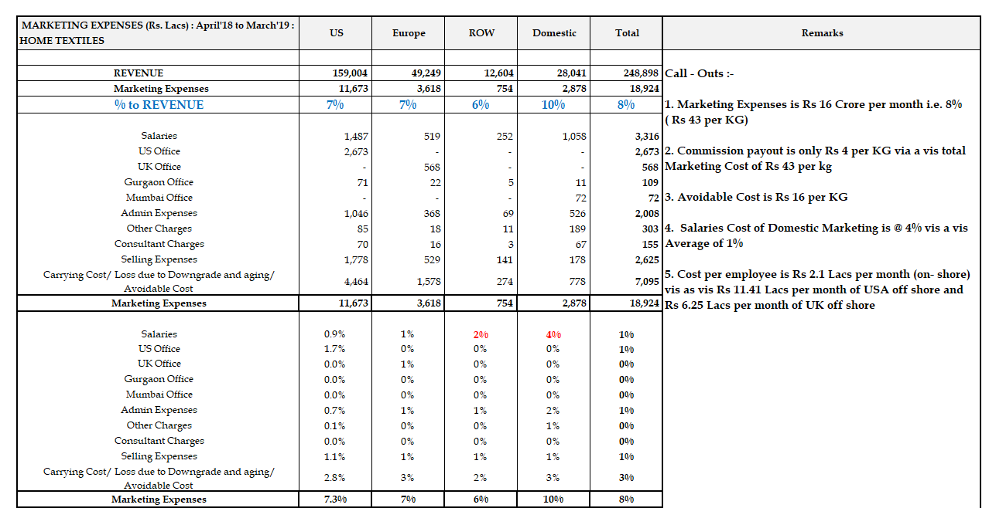
Home Textiles – Marketing Expenses to Revenue
Towel Marketing Cost-
Rs. 21/Kg (Towel)
Assuming
Zero Avoidable Cost of 12/Kg
Towel EBDITA/Kg: 35/Kg

Slide 28
Rate Trends – Last 10 Years - Towel
 | 2018-19 | 2017-18 | 2016-17 | 2015-16 | 2014-15 | 2013-14 | 2012-13 | 2011-12 | 2010-11 | 2009-10
INR/$ Rate | 69.44 | 64.73 | 66.73 | 65.41 | 61.87 | 60.92 | 54.44 | 49.40 | 45.17 | 46.86
Cotton Rate – Rs. /Kg | 117 | 116 | 106 | 97 | 113 | 106 | 104 | 119 | 98 | 69
Sales Qty-MT | 43,766 | 40,535 | 46,364 | 36,647 | 33,620 | 28,399 | 30,995 | 30,654 | 31,897 | 28,880
FOB Rate $ | 6.78 | 6.94 | 6.76 | 7.04 | 7.90 | 8.32 | 7.13 | 7.88 | 7.42 | 6.21
Conversion Cost – Rs/kg | 204 | 182 | 179 | 206 | 217 | 166 | 147 | 143 | 109 | 112
EBIDTA % | 8% |  |  |  |  |  |  |  |  | 20%
EBIDTA 8% for FY19 as compared to 20% in FT10
Conversion Cost has increased by Rs. 92 per Kg in last 10 Years (82%)

Slide 29
Cost Trends – Last 10 Years (Rs/ Kg) - Towel
 | 2018-19 | 2017-18 | 2016-17 | 2015-16 | 2014-15 | 2013-14 | 2012-13 | 2011-12 | 2010-11 | 2009-10
Raw Material Cotton:Yarn | 117/247 | 238 | 220 | 200 | 227 | 283 | 214 | 211 | 196 | 69/135
Dyes & Chemicals | 25 | 25 | 26 | 30 | 34 | 31 | 28 | 27 | 22 | 21
Packing Material | 26 | 25 | 22 | 20 | 20 | 17 | 14 | 13 | 12 | 11
Stores & Spares | 5 | 5 | 4 | 5 | 4 | 5 | 3 | 4 | 3 | 4
Bought Out Cost | 302 | 292 | 271 | 256 | 285 | 337 | 259 | 256 | 233 | 170
Salary | 56 | 56 | 57 | 58 | 56 | 37 | 28 | 27 | 25 | 26
Power & Fuel | 31 | 32 | 30 | 37 | 39 | 35 | 28 | 25 | 20 | 20
Admin Expenses | 28 | 3 | 10 | 17 | 16 | 14 | 21 | 22 | 5 | 5
Selling | 22 | 20 | 21 | 20 | 19 | 28 | 16 | 15 | 16 | 14
Total | 440 | 404 | 390 | 388 | 416 | 451 | 352 | 344 | 299 | 235
EBIDTA | 36 | 55 | 77 | 73 | 78 | 56 | 40 | 48 | 36 | 57
Finance costs | 7 | 7 | 5 | 7 | 13 | 9 | 9 | 9 | 8 | 9
Depreciation | 26 | 29 | 26 | 32 | 34 | 17 | 16 | 16 | 15 | 17
PBT | 3 | 20 | 45 | 35 | 31 | 30 | 15 | 23 | 13 | 32
+4
+15
+30
+11
+8
68/Kg

Slide 30
Trend – Last 10 Years (Rs. Cr) - Towel
Revenue Growth of 150% from 843 Cr to 2084 Cr in 10 Years
No Growth in EBIDTA in absolute terms

Slide 31
Towel /Kg : Revenue to PBT
Particulars | UOM | FY 17 | FY 18 | FY 19
GSR | Rs/Kg | 458 | 454 | 474
NSR | Rs/Kg | 438 | 421 | 455
Includes Subsidy |  |  |  | +36
Other Income/Forex Losses | Rs/Kg | 14 | 13 | (12)
RM Cost | Rs/Kg | 217 | 221 | 245
Dyes & Chemicals | Rs/Kg | 26 | 25 | 25
Packing Cost | Rs/Kg | 22 | 25 | 26
Stores & Spares | Rs/Kg | 5 | 5 | 5
Bought Out Cost | Rs/Kg | 271 | 276 | 300
Power & Fuel | Rs/Kg | 33 | 36 | 38
Admin Cost | Rs/Kg | 13 | 15 | 14
Personnel Cost | Rs/Kg | 55 (13%) | 61 | 56 (12%)
Conversion Cost | Rs/Kg | 101 | 112 | 107
EBDITA | Rs/Kg | 80 | 45 | 35
EBDITA | %age | 18% |  | 8%
Finance Cost (No WACC) | Rs/Kg | 5 | 7 | 7
Depreciation | Rs/Kg | 26 | 29 | 26
Includes Subsidy (We will not get Budni Subsidy anymore) |  |  |  | +14
PBT | Rs/Kg | 48 | 9 | 2

Slide 32
Towel Conversion Cost : KPIs
Towel Conversion Cost : KPI
Combined Financial Impact
Dhaula |  | Budhni
Power Units | 2.96 Units (12%+) | Power Units | 2.65 Units | 6 Cr
Steam Units | 8.09 Kgs | Steam Units | 9.00 Kgs (11%+) | 4 Cr
Wages (IL1 - IL3) | Rs. 34/Kg (100%+) | Wages (IL 1 - IL 3) | Rs. 17/Kg | 36 Cr
Non Wages : Plant | Rs. 23/Kg | Non Wages : Plant | Rs. 20/Kg | 22 Cr
Non Wages : Non Plant | Rs. 9/Kg | Non Wages : Non Plant | Rs. 10/Kg
% of Salary to Non-Production | 48% | % of Salary to Non-Production | 63% | Assuming 2:1 Ratio
Stores & Spares | Rs. 7/Kg | Stores & Spares | Rs. 4/Kg
 |  |  | 68 Crores

Slide 33
THT 1 Power Consumption Trends ( KWH/KG)
Target 2.43 KWH / KG

Slide 34
THT 2 Power Consumption Trends ( KWH/KG)
Target 2.43 KWH / KG

Slide 35
TBT Power Consumption Trends ( KWH/KG)
Target 2.43 KWH / KG

Slide 36
THT 1 Steam Consumption Trends ( KG/KG)

Slide 37
THT 2 Steam Consumption Trends ( KG/KG)
Target 5.16 KG / KG

Slide 38
TBT Steam Consumption Trends ( KG/KG)
Target 5.16 KG / KG

Slide 39
Towel Annual Dyes & Chemical Cost (Crores)
Dyes & Chemicals Cost
 | Category | Material description | UOM | Annual Purchase (Crs) | % to Total |  | Category | Material description | UOM | Annual Purchase (Crs) | % to Total
 | Hydrogen Peroxide | HYDROGEN PEROXIDE 60% | KG | 11.70 | 10% |  | Dyes | NOVACRON YELLOW S-3R | KG | 1.06 | 1%
 | Dyes | NOVACRON OCEAN SR | KG | 6.28 | 5% |  | Dyes | NOVACRON YELLOW EC-2R | KG | 1.04 | 1%
 | Caustic Lye&Bi Prod. | CAUSTIC SODA LYE(100%) | KG | 5.01 | 4% |  | Dyes | NOVACRON DEEP RED EC-D | KG | 1.04 | 1%
 | Chemical | SICOFLEX TT | KG | 4.90 | 4% |  | Dyes | NOVACRON BLUE EC-R | KG | 0.98 | 1%
 | Acid | GREEN ACID | KG | 4.55 | 4% |  | Dyes | AVITERA BLUE SE(HUNTSMAN) | KG | 0.96 | 1%
 | Chemical | ULTRATEX TTK (HUNTSMAN) | KG | 3.85 | 3% |  | Dyes | AVITERA DEEP SEA SE (HUNTSMAN) | KG | 0.94 | 1%
 | Dyes | RUBY S3B (HUNTSMAN) | KG | 3.47 | 3% |  | Chemical | UVITEX BST | KG | 0.90 | 1%
 | Chemical | SILIGEN ATS LIQ. | KG | 3.30 | 3% |  | Dyes | NOVACRON RED EC-2BL | KG | 0.88 | 1%
 | Soda Ash | SODA ASH LIGHT | KG | 3.18 | 3% |  | Dyes | NOVACRON OLIVE EC-NC | KG | 0.86 | 1%
 | Chemical | MARVEL KSM SPL LIQUID | KG | 3.07 | 3% |  | Salt | IRON FREE CRYSTAL SALT-NACL | KG | 0.78 | 1%
 | Chemical | PRIMAFAST LUNA RL | KG | 2.54 | 2% |  | Dyes | NOVACRON NAVY EC-BN | KG | 0.72 | 1%
 | Chemical | ULTRAVON CPR | KG | 2.52 | 2% |  | Chemical | ALBFLOW CONTI | KG | 0.68 | 1%
 | Chemical | ULTRAVON RW (CIBA) | KG | 2.29 | 2% |  | Chemical | CELLUNASE COMBI (+) | KG | 0.63 | 1%
 | Dyes | NOVACRON YELLOW CNPC | KG | 2.26 | 2% |  | Chemical | HYDROCOL HCF(FIXING AGENT) | KG | 0.63 | 1%
 | Dyes | AVITERA DEEP BLUE SE | KG | 2.11 | 2% |  | Dyes | NOVACRON BROWN EC-NC | KG | 0.61 | 1%
 | Dyes | AVITERA LIGHT BLUE SE | KG | 2.08 | 2% |  | Dyes | AVITERA YELLOW SE | KG | 0.60 | 1%
 | Dyes | NOVACRON BLUE EC-GC | KG | 1.87 | 2% |  | Dyes | NOVACRON GREY EC-NC | KG | 0.55 | 0%
 | Salt | REFINED SALT(PPM LESS THAN 150) | KG | 1.73 | 1% |  | Chemical | NEUTRAFAB CMG (ROSSARI) | KG | 0.54 | 0%
 | Acid | SULPHURIC ACID (COMM.GR. AS INPUT) | KG | 1.27 | 1% |  | Dyes | SYNOZOL SCARLET K-SR | KG | 0.39 | 0%
 | Chemical | KLEENOX WET | KG | 1.21 | 1% |  | Dyes | NOVACRON YELLOW C-5G | KG | 0.38 | 0%
 | Chemical | ALBAFIX ECO { HUNTSMAN} | KG | 1.18 | 1% |  | Dyes | SYNOZOL GREY KHL | KG | 0.29 | 0%
 | Dyes | NOVACRON RED EC-3B | KG | 1.17 | 1% |  | Chemical | ZYCOL TSA ( ROSSARI) | KG | 0.26 | 0%
 | Sodium Sulphate | SODIUM SULPHATE (LOW PH) | KG | 1.09 | 1% |  | Dyes | SYNOZOL NAVY BLUE K-BF | KG | 0.21 | 0%
 | Dyes | NOVACRON TURQUOISE EC-GN | KG | 1.07 | 1% |  | Dyes | SYNOZOL BLUE K-HL | KG | 0.12 | 0%
 | Dyes | NOVACRON BLUE C-D | KG | 1.06 | 1% |  |  | Others |  | 28.78 | 24%
 |  |  |  |  |  |  | Total Dyes & Chemical Procurement |  |  | 119.54 | 100%

Slide 40
Dyes & Chemical - Saving Scope of Rs 5 Crores +

Slide 41
Avoidable Cost ( FY 2018-19)
Air Freight, Payment Defaults, Rebate & Discounts, Fast Movement Charges, Non RFT Losses

Slide 42
Opportunity/Losses
 | In Crores
Losses | FY 19
Towel Capacity Unsold @ 100/Kg | 468
Sheeting Capacity Unsold @ 20% EBDITA | 200
Towel High Conversion Cost - Dhaula v/s Budhni | 68
Home Textile COPQ (Non RFT) | 65
Home Textiles : Claims, DSR, Penalty, Defaults, FBC etc | 19
Home Textiles: Air Freight | 9
Towel: Black Hole Orders - EBIDTA loss | 18
Home Textiles: WIP > 30 Days Carrying Cost | 16
Home Textiles: Finished Goods > 15 Days Carrying Cost | 10
Home Textiles: Debtors > Payment terms | 13
A Grade to Downgrade | 6
Total | 892

Slide 43
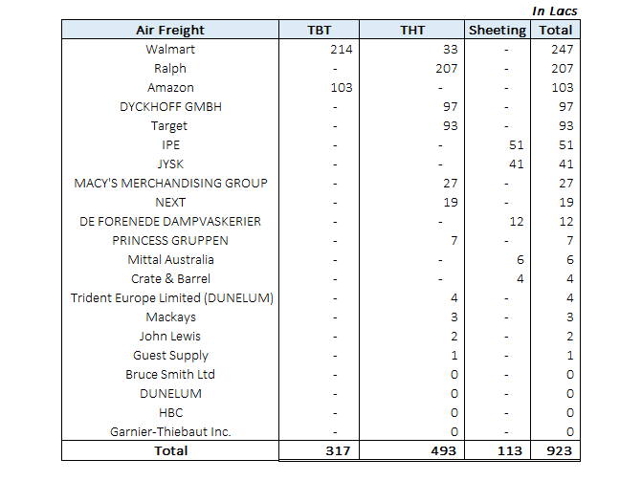
Air Freight (FY 19)

Slide 44
Quality Claims, Late Delivery Charges, DSR Claims, Payment Defaults
 |  |  | In Lacs
Particulars | Sheeting | Towel | Total
DSR Claim | 727 | 108 | 835
Payment Defaults | - | 278 | 278
FBC | 27 | 178 | 205
Quality Claim | 1 | 190 | 191
Late Delivery | 25 | 108 | 133
Interest Write off | 4 | 25 | 29
Chargeback | 26 | - | 26
Others Claim & Charges | 4 | 207 | 208
Total | 813 | 1,094 | 1,904

Slide 45
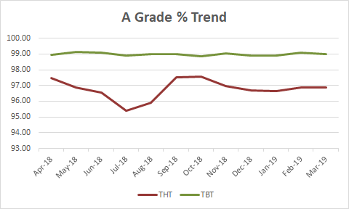
Towel A Grade % Trends
Particulars | THT-1 | THT-2 | THT | TBT
Std Deviation % | 1.35 | 0.90 | 0.64 | 0.09
A Grade %-2018-19
Month | THT-1 | THT-2 | THT | TBT
Apr-18 | 96.71 | 97.82 | 97.47 | 98.97
May-18 | 95.45 | 97.62 | 96.87 | 99.15
Jun-18 | 96.40 | 96.63 | 96.55 | 99.11
Jul-18 | 97.15 | 94.47 | 95.40 | 98.92
Aug-18 | 92.55 | 97.40 | 95.89 | 99.02
Sep-18 | 97.45 | 97.55 | 97.52 | 99.01
Oct-18 | 97.06 | 97.75 | 97.56 | 98.86
Nov-18 | 96.79 | 97.02 | 96.95 | 99.04
Dec-18 | 96.02 | 97.01 | 96.71 | 98.91
Jan-19 | 94.88 | 97.40 | 96.65 | 98.91
Feb-19 | 95.31 | 97.52 | 96.89 | 99.09
Mar-19 | 96.45 | 97.07 | 96.89 | 99.01
FY-18-19 | 96.06 | 97.18 | 96.84 | 99.00
Apr-19 | 95.22 | 96.60 | 96.15 | 99.06
Month | THT-1 | THT-2 | THT | TBT
FY-16-17 | 96.00 | 97.00 | 96.70 | 98.96
FY-17-18 | 96.97 | 97.15 | 97.10 | 98.93
FY-18-19 | 96.06 | 97.18 | 96.84 | 99.00

Slide 46
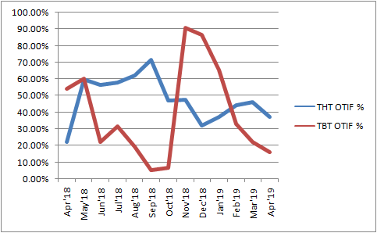
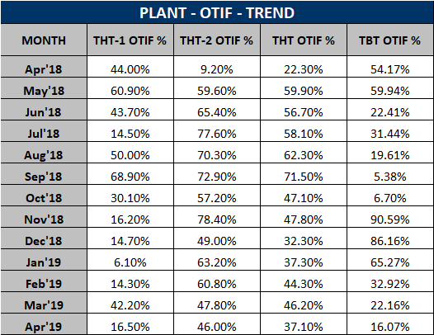
Plant OTIF Trend ( Based upon number of orders)
Based upon Quantity – Not Done

Slide 47
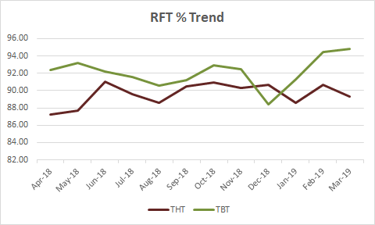
Towel RFT % Trends
Particulars | THT-1 | THT-2 | THT | TBT
Std Deviation % | 0.82 | 1.91 | 1.31 | 1.71
Final RFT-2018-19 %
Month | THT-1 | THT-2 | THT | TBT
Apr-18 | 93.53 | 84.79 | 87.25 | 92.41
May-18 | 92.56 | 85.42 | 87.68 | 93.23
Jun-18 | 93.05 | 90.29 | 91.04 | 92.23
Jul-18 | 91.40 | 88.69 | 89.56 | 91.56
Aug-18 | 90.57 | 87.95 | 88.56 | 90.54
Sep-18 | 92.43 | 89.79 | 90.48 | 91.25
Oct-18 | 92.84 | 90.20 | 90.92 | 92.93
Nov-18 | 92.89 | 89.21 | 90.28 | 92.46
Dec-18 | 91.99 | 90.29 | 90.70 | 88.45
Jan-19 | 93.03 | 87.18 | 88.57 | 91.32
Feb-19 | 92.38 | 90.13 | 90.67 | 94.43
Mar-19 | 93.10 | 87.79 | 89.28 | 94.80
YTD | 92.48 | 88.48 | 89.58 | 92.24
Apr-19 | 95.46 | 90.09 | 91.51 | 93.72
Month | THT-1 | THT-2 | THT | TBT
FY-16-17 | 91.06 | 88.07 | 88.95 | 91.85
FY-17-18 | 91.94 | 86.70 | 87.97 | 90.15
FY-18-19 | 92.48 | 88.48 | 89.58 | 92.24

Slide 48
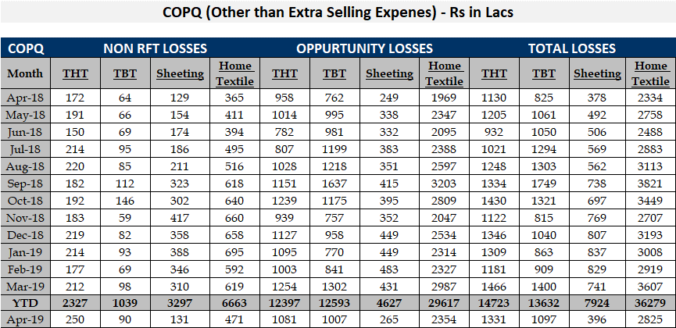
COPQ Other Than Air Freight and Claims

Slide 49
THANK YOU
May 28, 2019

